Slide 1
Super Shopping List
Do’s 8
Mica Haney ⁕ Mustafa Memon ⁕ Nestor Molina ⁕ Vandana Sinha ⁕ Nikhil Gaur ⁕ Brice Brosig ⁕ Tam Doan ⁕ Naveen Raja Yalagandula
Notes:
Mica

Slide 2
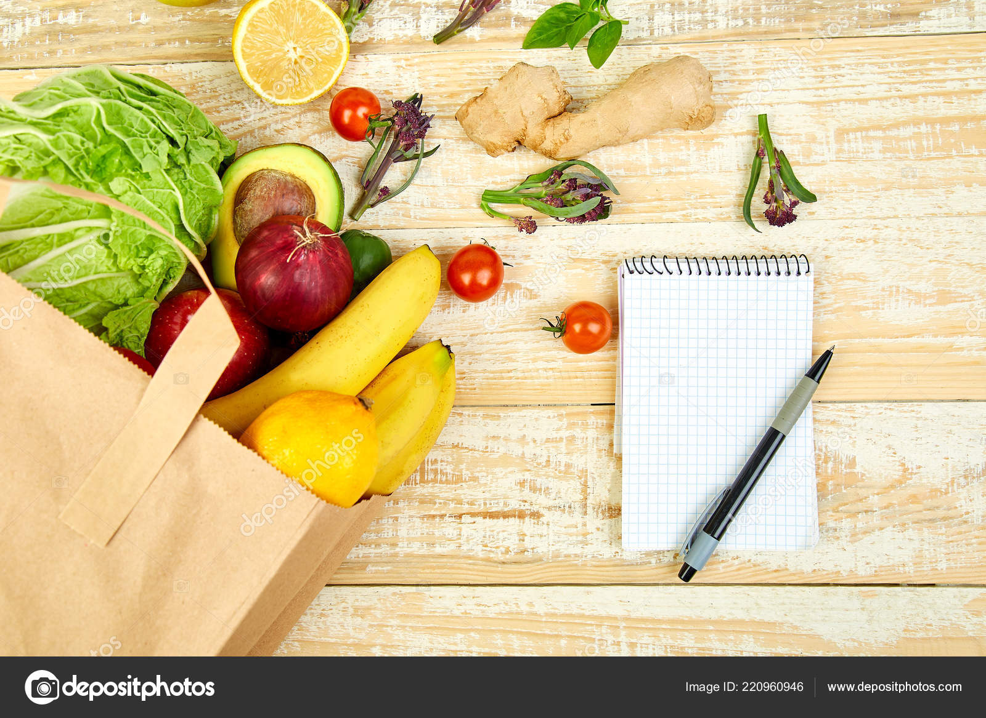
Overview
The user selects the recipes they want to make.
A shopping list automatically compiles.
The list can be accessed via a mobile application.
Notes:
Mica

Slide 3

Website
This is where the user will be able to select recipes, add and edit recipes, build a recipe book, and edit their shopping list.
This will be the workhorse of the system for the user.
Python Flask Javascript HTML CSS
Notes:
Brice

Slide 4
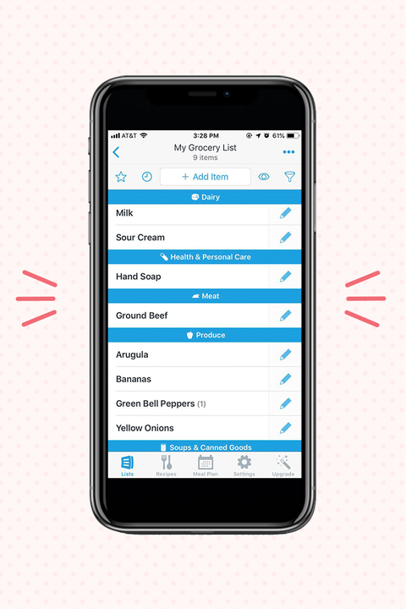
Android App
This will be largely the shopping list.
Other functionalities from the website will be included, but stripped down for mobile.
Java Kotlin
Notes:
Mustafa

Slide 5
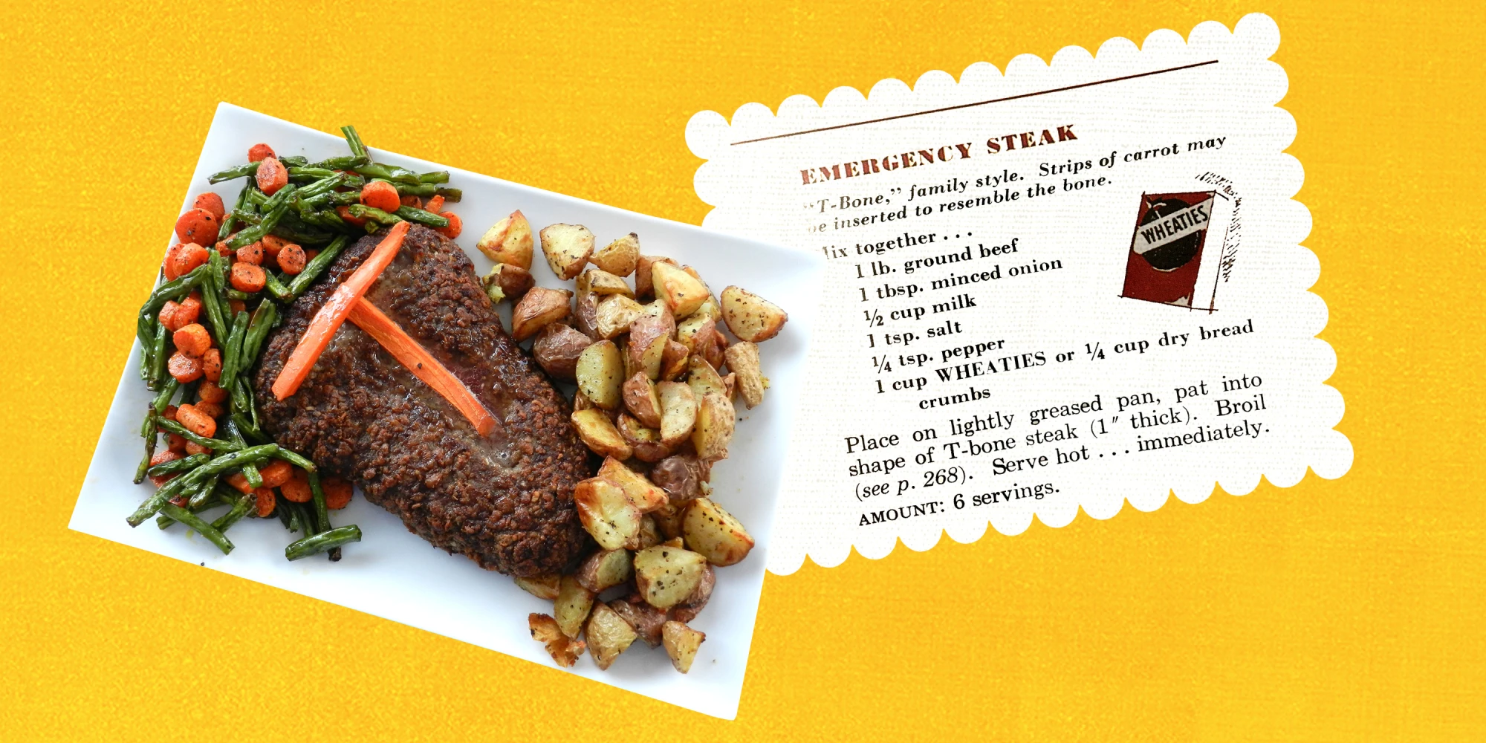
Recipes
The recipes book will start with a set of recipes sourced from the Internet.
Users will have the ability to add their own recipes.
Users will have the option of not publicly posting their recipes.
The public recipe book will be started by the administrators, but added to by the users.
Notes:
Nestor

Slide 6
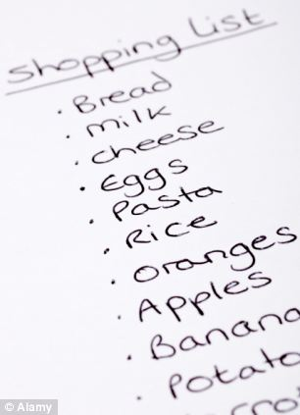
Shopping List
The shopping list will generate automatically based on the ingredients and their amounts in the chosen recipes.
The user will be able to change the volume of a recipe (such as doubling) and the shopping list will account for that.
Notes:
Tam

Slide 7

Inventory
There will be a pantry inventory so that ingredients the user already has don’t go onto the shopping list.
Notes:
Nikhil

Slide 8

Calendar
The calendar function will allow users to plan what day they’re having which meals, and when they go to the store.
This will allow users to plan meals far in advance.
Notes:
Vandana

Slide 9
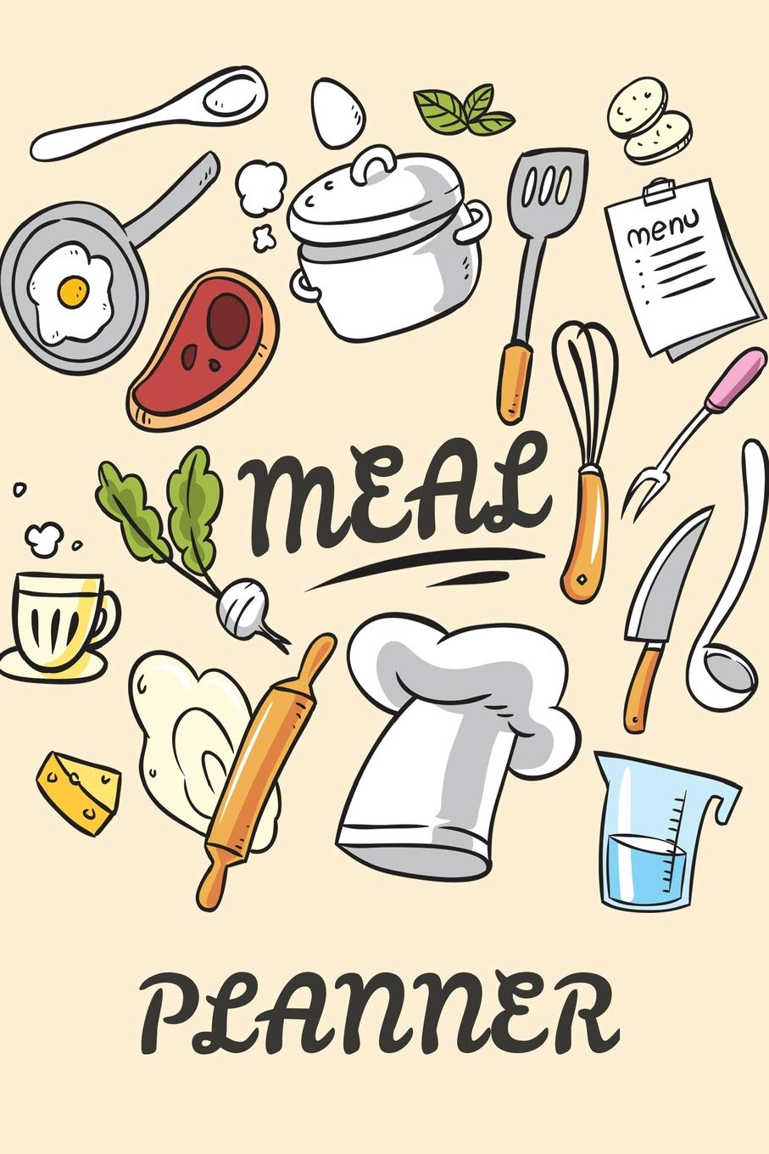
Meal Plan
The meal plan will be the number of days that the user intends to shop for.
The user can look at and edit recipe amounts here (doubling or halving).
Notes:
Naveen

Slide 10
Sources
https://www.today.com/food/we-tried-emergency-steak-reddit-famous-vintage-recipe-t209920
http://clipart-library.com/clipart/1949743.htm
https://depositphotos.com/220960946/stock-photo-shopping-list-recipe-book-diet.html
https://www.addthis.com/academy/how-to-create-engaging-website-design/
https://www.goodhousekeeping.com/food-recipes/g26255008/best-grocery-shopping-list-apps/
https://www.onsightapp.com/blog/top-reasons-why-inventory-management-matters
https://www.quapawbsa.org/wp-content/uploads/2020/12/Calendar-900x500-1.jpg
https://www.amazon.com/Meal-Planner-Calendar-Planning-Planners/dp/1727540948

